Slide 1
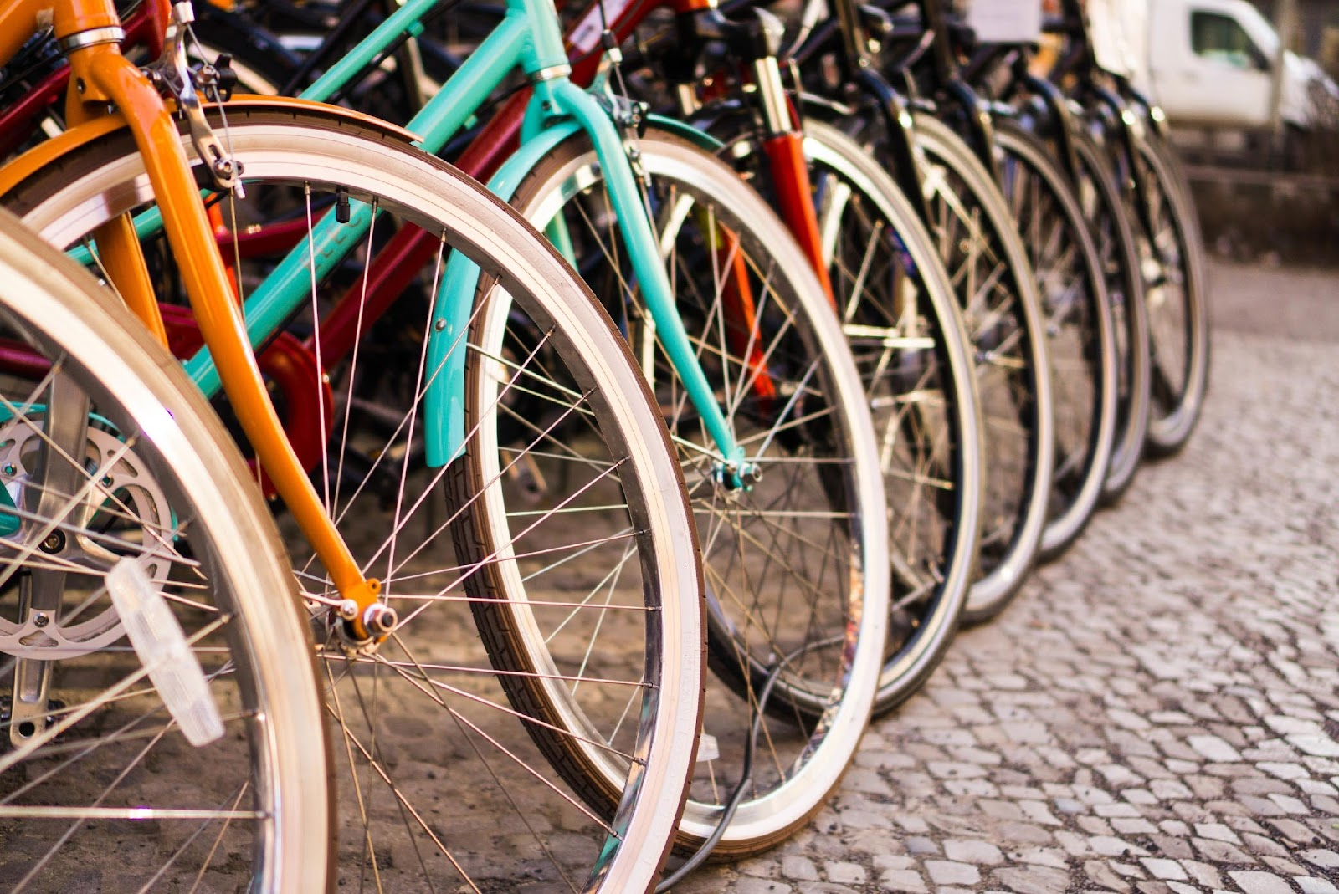
Cycling in London Final Presentation
TEAM 4: MEGAN BILAS, HAZEL CHAN, AKIRA LEYOW, TED MALUMBE, RICHARD LI CHEN ZHOU

Slide 2
Agenda
1
Background/Context
Project Development Process
Insights, patterns, trends, recommendations
What is the trend in total cycles over time?
What are the main factors determining when people cycle?
What impact does infrastructure have on cycling uptake and how can this be improved?
What are the demographics of cyclists in London?
How safe is it to cycle in London?
What is the sentiment towards cycling in London?
Conclusion
2
3
4

Slide 3
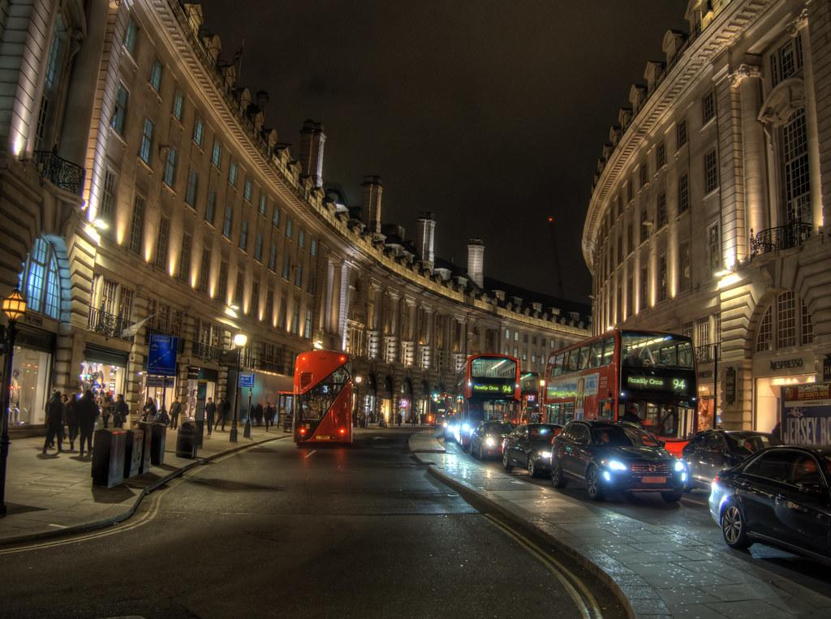
Background/context
“Car dependency has contributed to an increase in poor public health across our city. Streets can often be polluted, congested and dangerous – unwelcoming places to walk or cycle. Tube, rail and bus services can be overcrowded and sometimes unreliable and indirect, meaning there is no appealing alternative to car use for many.”
“The central aim is for 80% of all trips in London to be made on foot, by cycle or using public transport by 2041.”
(Mayor’s Transport Strategy 2018)

Slide 4
Business Case
Problem statement: How can we increase the uptake of cycling in London in order to create a more sustainable transport system?
What is the trend in total cycles over time?
Q1. What are the main factors determining when people cycle?
Q2. What impact does infrastructure have on cycling uptake and how can this be improved?
Q3. What are the demographics of cyclists in London?
Q4. What is the sentiment towards cycling in London?
Q5. How safe is it to cycle in London?
Areas of exploration: time of year; time of day; weather; direction of travel; reasons for cycling
Areas of exploration: private vs cycle hire; locations with the least number of cycles
Areas of exploration: gender
Areas of exploration: top words appearing; polarity score; top 20 positive/negative tweets
Areas of exploration: theft; road casualties
Data: TfL central, inner, outer datasets; GOV.UK walking and cycling statistics
Data: GOV.UK reported road casualties; data.london.gov.uk
Data: TfL central, inner, outer datasets
Data: TfL outer dataset
Data: Twitter

Slide 5
Transport for London (TfL)’s spatial approach
Central London
Business hub dependent on high levels of transport connectivity; most concentrated mix for public space; space at a premium
Inner London
Densely developed area with population and employment numbers expected to rise; area presents the greatest immediate opportunity to reduce car use by transforming facilities for people cycling
Outer London
Where majority of residents live; trips tends to be longer with many different start and end points; cycling has huge potential to replace shorter car trips

Slide 6
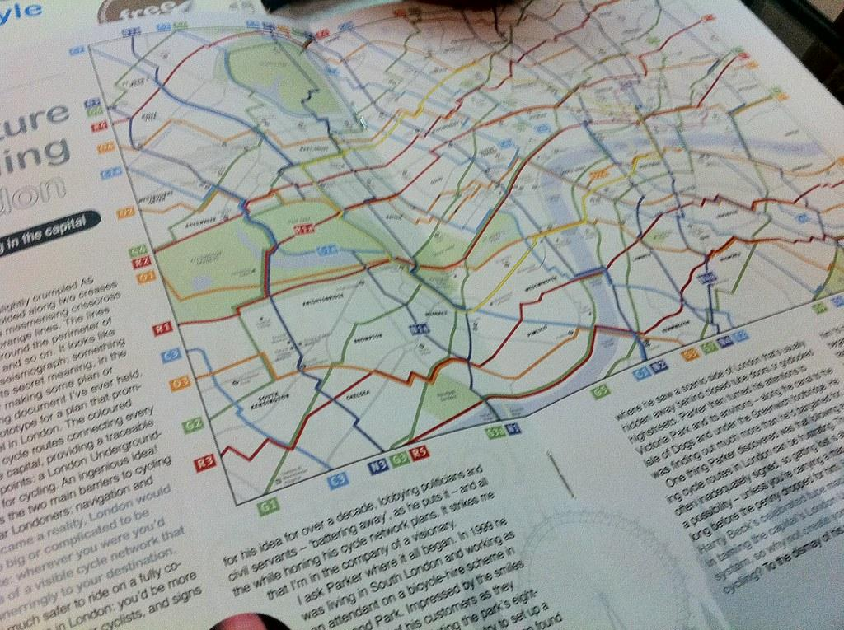
Project Development Process

Slide 7
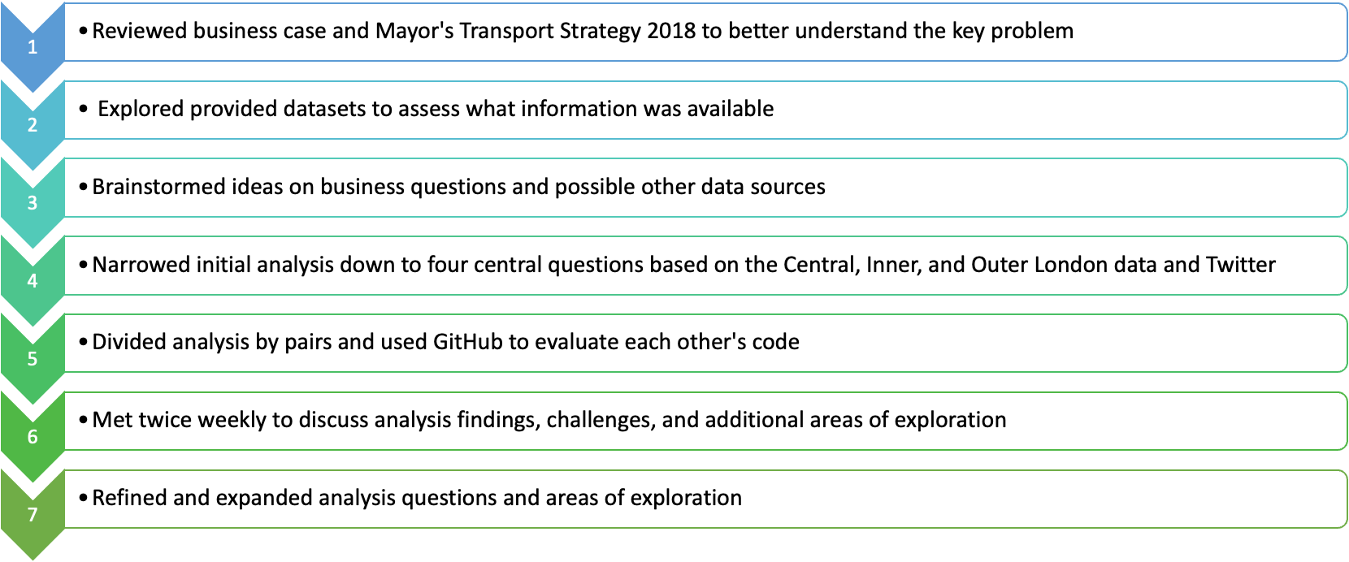
Development

Slide 8
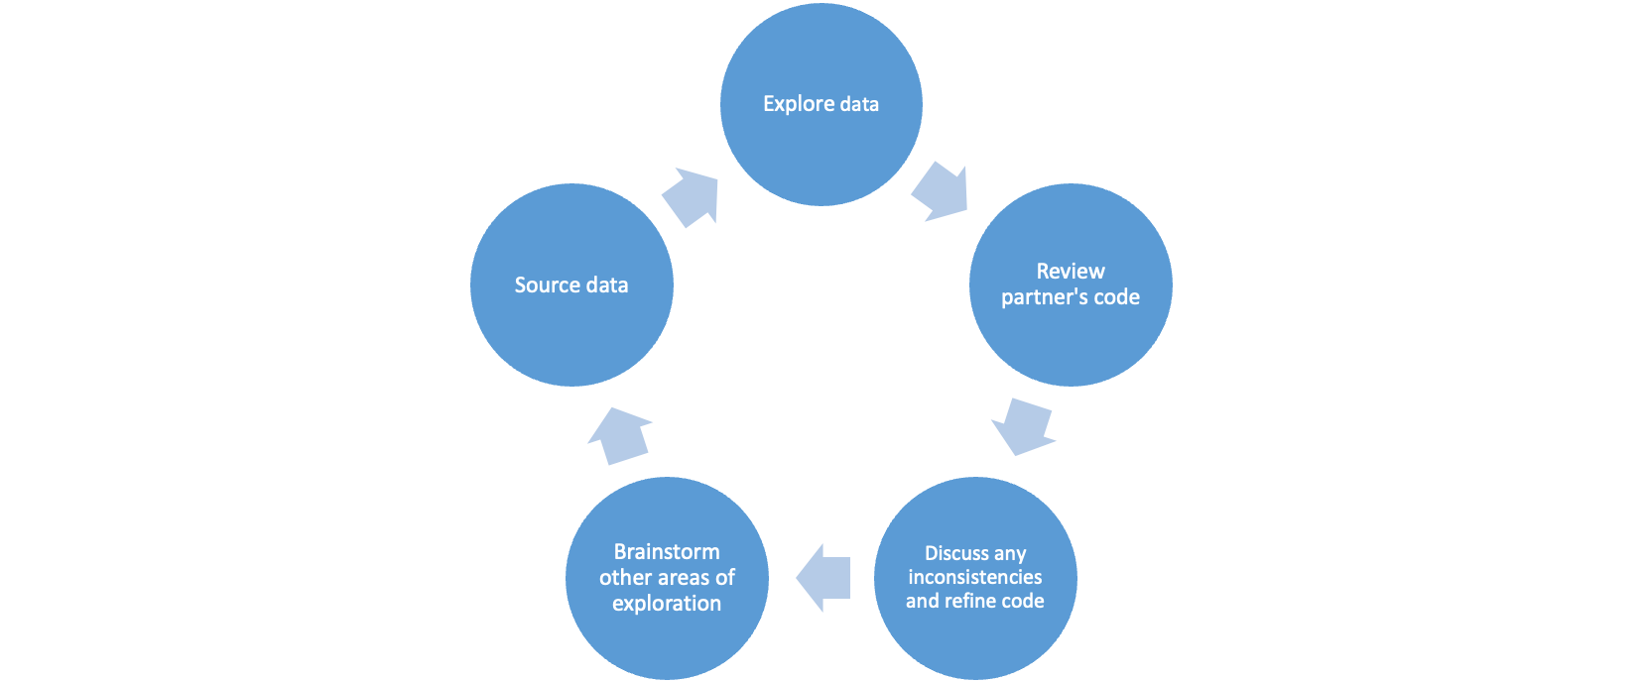
Analysis Process

Slide 9
Initial Business Case
Problem statement: How can we increase the uptake of cycling in London in order to create a more sustainable transport system?
What is the trend in total cycles over time?
Q1. What are the main factors determining when people cycle?
Q2. What impact does infrastructure have on cycling uptake?
Q3. What are the demographics of cyclists in London?
Q4. What is the sentiment towards cycling in London?
Areas of exploration: time of year; time of day; weather; direction of travel
Areas of exploration: private vs cycle hire
Areas of exploration: gender
Areas of exploration: polarity score
Data: TfL central, inner, outer datasets; GOV.UK walking and cycling statistics
Data: TfL inner and outer datasets
Data: TfL outer dataset
Data: Twitter

Slide 10
Expanded Business Case
Problem statement: How can we increase the uptake of cycling in London in order to create a more sustainable transport system?
highlight indicates change made to initial business case
What is the trend in total cycles over time?
Q1. What are the main factors determining when people cycle?
Q2. What impact does infrastructure have on cycling uptake and how can this be improved?
Q3. What are the demographics of cyclists in London?
Q4. What is the sentiment towards cycling in London?
Q5. How safe is it to cycle in London?
Areas of exploration: time of year; time of day; weather; direction of travel; reasons for cycling
Areas of exploration: private vs cycle hire; locations with the least number of cycles
Areas of exploration: gender
Areas of exploration: top words appearing; polarity score; top 20 positive/negative tweets
Areas of exploration: theft; road casualties
Data: TfL central, inner, outer datasets; GOV.UK walking and cycling statistics
Data: GOV.UK reported road casualties; data.london.gov.uk
Data: TfL central, inner, outer datasets
Data: TfL outer dataset
Data: Twitter

Slide 11
Challenges and Decisions/Solutions
Business Question | Challenges | Decisions/Solutions
Q1. What are the main factors determining when people cycle? | When analysing the aggregated data (central, inner, outer London), the trends are thrown off by the central London dataset due to the higher number of observations in this dataset in comparison to inner and outer London. Data was available on reasons for cycling but the format of the file could not easily be read into Python. | Decided to split the analysis by the three regions in London This is in line with TfL’s spatial strategy of looking at each of the regions individually due to the different concerns in each region. Reorganised data into a simplified csv file in Excel.
Q2. What impact does cycling infrastructure have on cycling uptake? | Only inner and central london has data on private vs cycle hires, unable to compare with outer london. Lack of data on categorising location to draw further correlation. | Conducted analysis separately for each area of london to examine cycles between private vs hire. Used common variable “total cycles” to identify roads used least for cycling as areas for infrastructure improvement.
Q3. What are the demographics of cyclists in London? | The dataset did not have much demographic data beyond gender and it would have been better to also leverage income, age, employment status and race. | Carried out as much bivariate analysis as the dataset would allow. Since even attempts to gather external data were meet with paywalls.
Q4. What is the sentiment towards cycling in London? | Geolocation can only be used to find trends per city. When searching for “#cycle”, worldwide results were produced rather than those specific to London, England. | An alternative method for searching for several keywords was used (Tweepy). The search criteria was expanded to “london uk cycle” to narrow results to London, England.
Q5. How safe is it to cycle in London? | Data was available on cyclist accidents but the format of the file could not easily be read into Python. | Reorganised data into a simplified csv file in Excel.

Slide 12
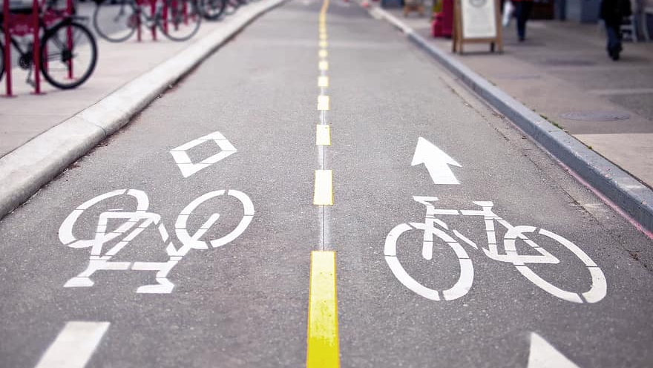
Insights, Patterns, Trends, Recommendations

Slide 13
Business Case
Problem statement: How can we increase the uptake of cycling in London in order to create a more sustainable transport system?
What is the trend in total cycles over time?
Q1. What are the main factors determining when people cycle?
Q2. What impact does infrastructure have on cycling uptake and how can this be improved?
Q3. What are the demographics of cyclists in London?
Q4. What is the sentiment towards cycling in London?
Q5. How safe is it to cycle in London?
Areas of exploration: time of year; time of day; weather; direction of travel; reasons for cycling
Areas of exploration: private vs cycle hire; locations with the least number of cycles
Areas of exploration: gender
Areas of exploration: top words appearing; polarity score; top 20 positive/negative tweets
Areas of exploration: theft; road casualties
Data: TfL central, inner, outer datasets; GOV.UK walking and cycling statistics
Data: GOV.UK reported road casualties; data.london.gov.uk
Data: TfL central, inner, outer datasets
Data: TfL outer dataset
Data: Twitter

Slide 14
Code considerations
Used time-series plot to find overall trends of the data.
Used seasonal-decomposition to see trends and seasonality of each data set.
Used rolling statistics and Augmented Dickey-Fuller test to check for stationarity of data.
Applied SARIMA (Seasonal Autoregressive Integrated Moving Average) model to forecast future cycles.
Used AIC evaluation metric for grid-search to find best parameters.
Produced one-step ahead forecast and dynamic forecast for comparison.
Checked residuals over time, find out if the residuals are normally distributed, ordered distribution of residuals and autocorrelation plot to find best-fitting model.
Made predictions for 2 years and plotted out visualisation for highlighting specific periods.

Slide 15
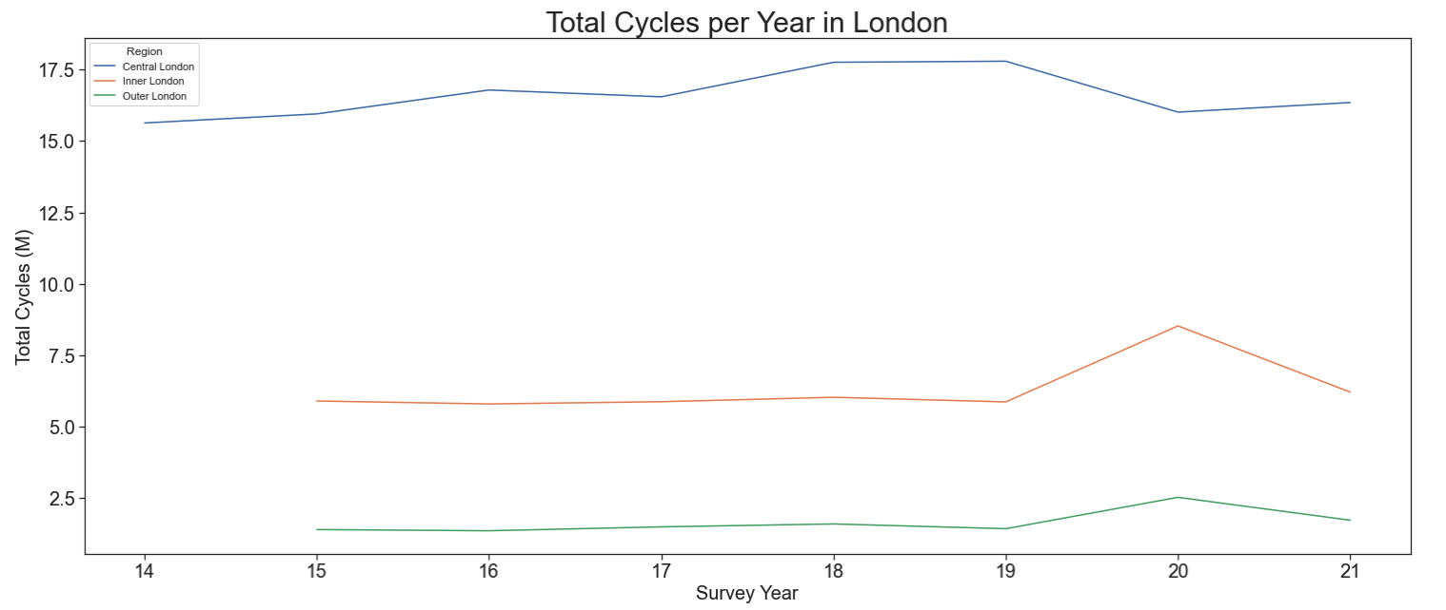
The number of cycles has been steadily increasing in central London since 2014 but decreased in 2020. In contrast, the number of cycles in inner and outer London has remained steady since 2015 but increased in 2020. This is likely due to the effects of the pandemic.

Slide 16
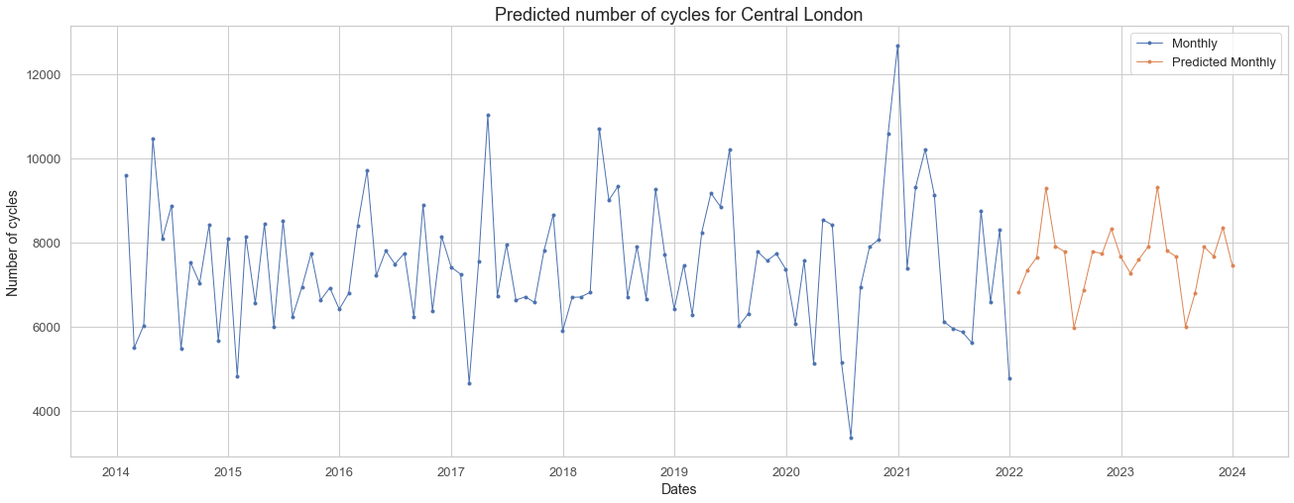
We don’t see any big changes in central London for the future
Forecasting model: ARIMA

Slide 17
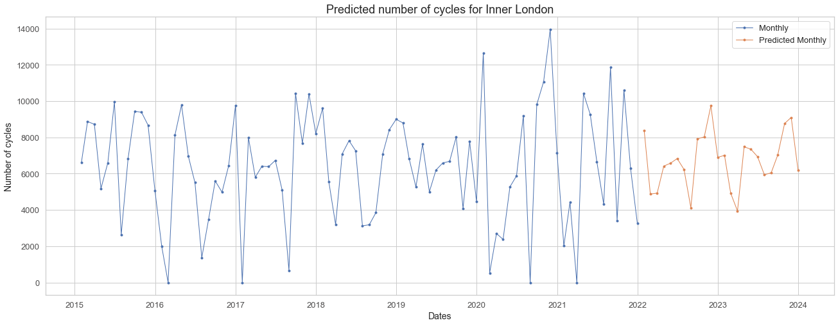
We see a similar trend in inner London
Forecasting model: ARIMA

Slide 18
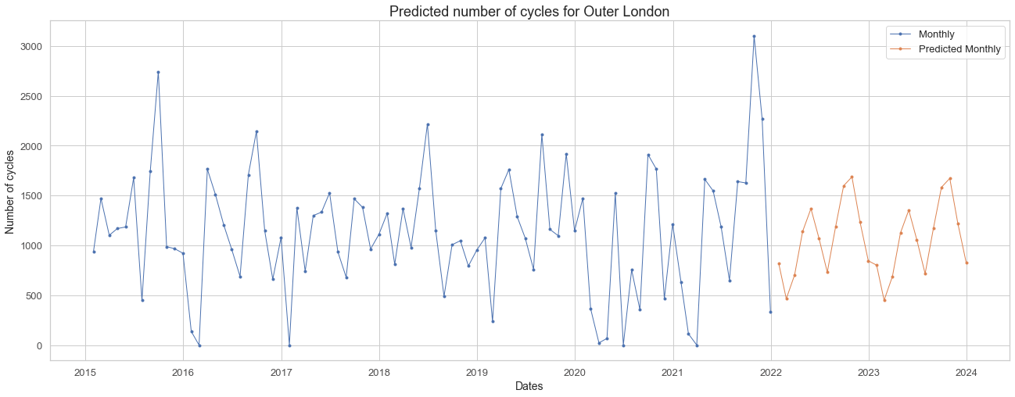
And a similar trend in outer London
Forecasting model: ARIMA

Slide 19
Business Case
Problem statement: How can we increase the uptake of cycling in London in order to create a more sustainable transport system?
What is the trend in total cycles over time?
Q1. What are the main factors determining when people cycle?
Q2. What impact does infrastructure have on cycling uptake and how can this be improved?
Q3. What are the demographics of cyclists in London?
Q4. What is the sentiment towards cycling in London?
Q5. How safe is it to cycle in London?
Areas of exploration: time of year; time of day; weather; direction of travel; reasons for cycling
Areas of exploration: private vs cycle hire; locations with the least number of cycles
Areas of exploration: gender
Areas of exploration: top words appearing; polarity score; top 20 positive/negative tweets
Areas of exploration: theft; road casualties
Data: TfL central, inner, outer datasets; GOV.UK walking and cycling statistics
Data: GOV.UK reported road casualties; data.london.gov.uk
Data: TfL central, inner, outer datasets
Data: TfL outer dataset
Data: Twitter

Slide 20
Code considerations
When analysing the aggregated data (central, inner, outer London), the trends are thrown off by the central London dataset due to the higher number of observations in this dataset in comparison to inner and outer London.
We decided to split the analysis by the three regions in London. This is in line with TfL’s spatial strategy of looking at each of the regions individually due to the different concerns in each region.
There were many values for ‘Weather.’ Therefore, the analysis was limited to those values with 1000 or more observations.

Slide 21
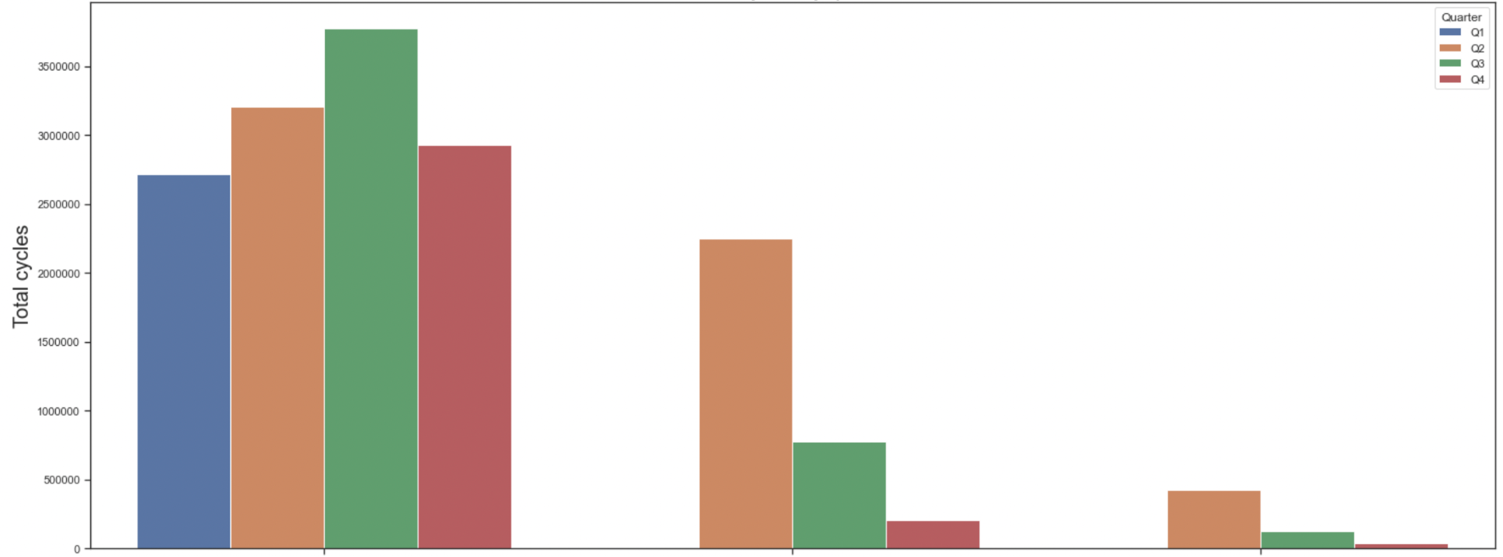
There are more cyclists in Q2 and Q3 (Apr-Sep) of each year
Q1: Jan-Mar
Q2: Apr-Jun
Q3: Jul-Sep
Q4: Oct-Dec
Central London
Inner London
Outer London

Slide 22
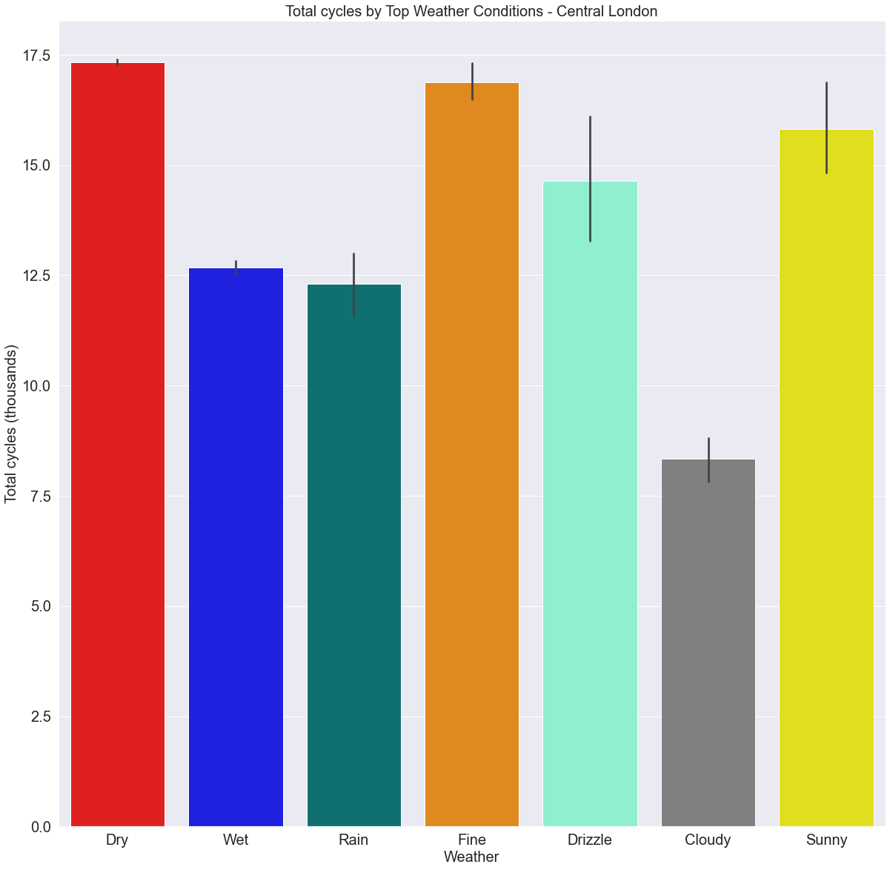
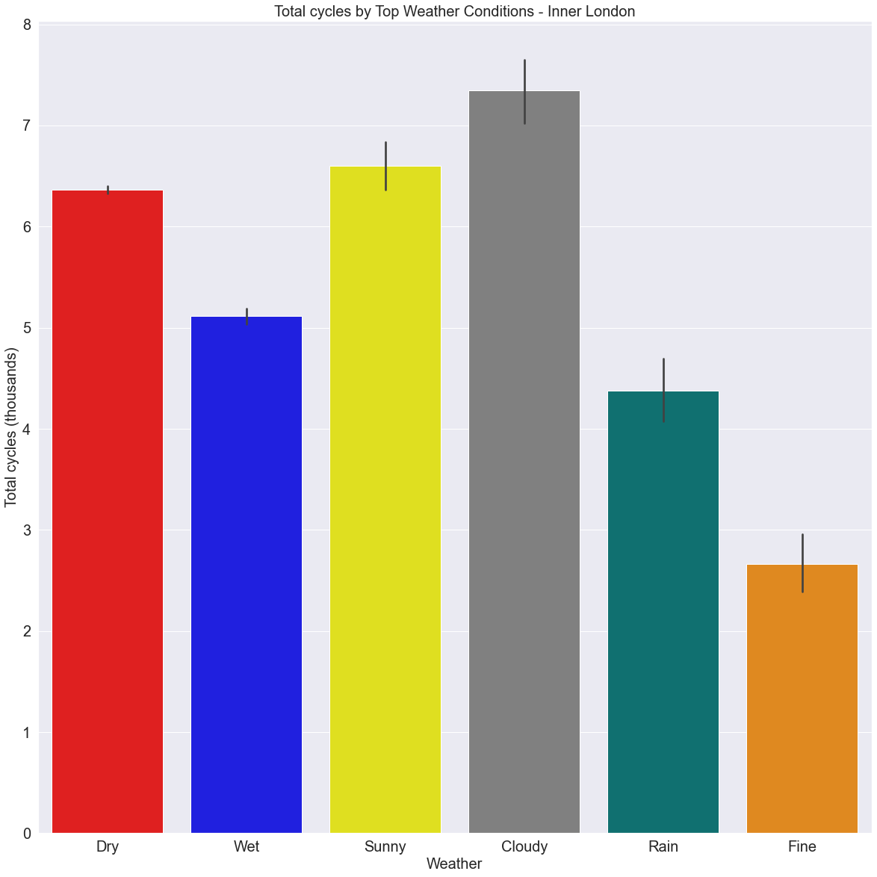
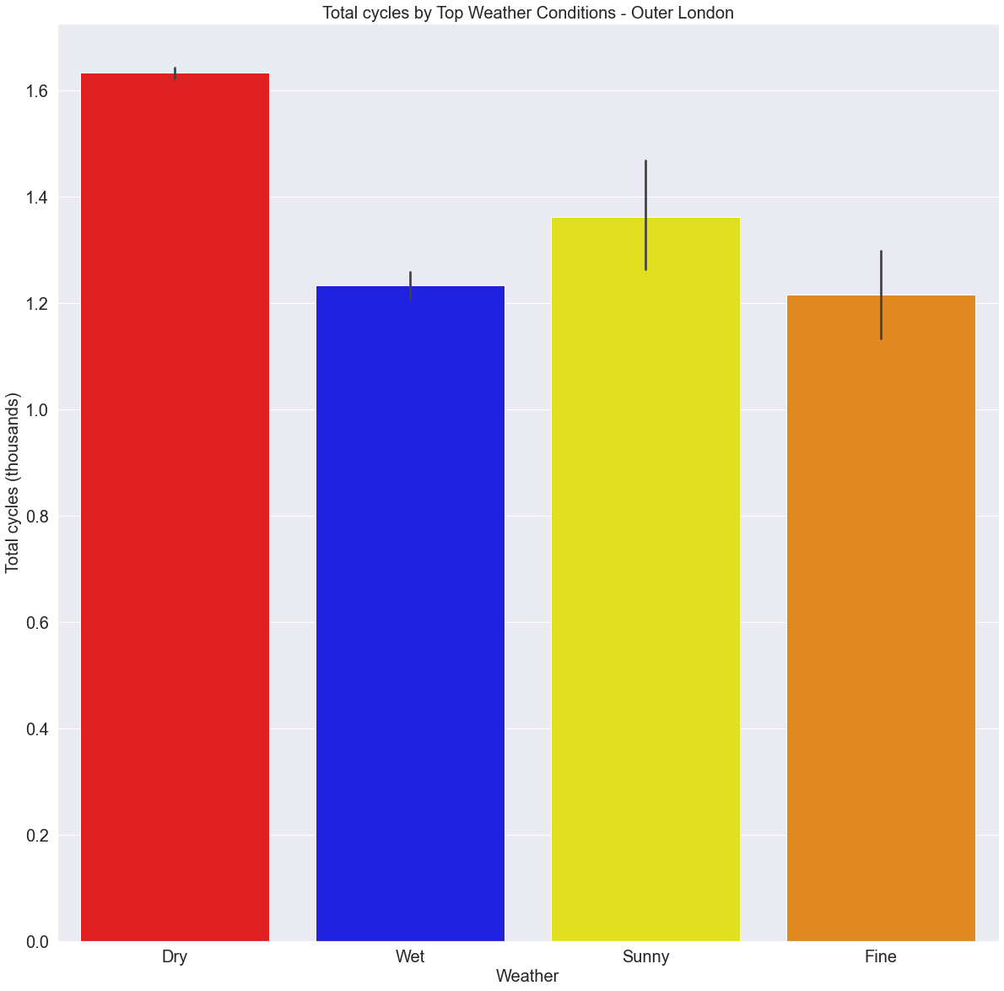
People tend to cycle more in good weather
(generally dry, sunny, fine)
Central London
Inner London
Outer London
8
17.5
1.6
7
15.0
1.4
6
12.5
1.2
5
Total cycles (M)
1.0
10.0
4
0.8
7.5
3
0.6
5.0
2
0.4
2.5
1
0.2
0.0
0
0.0
Dry
Wet
Rain
Fine
Drizzle
Cloudy
Sunny
Dry
Wet
Sunny
Cloudy
Rain
Fine
Dry
Wet
Sunny
Fine

Slide 23
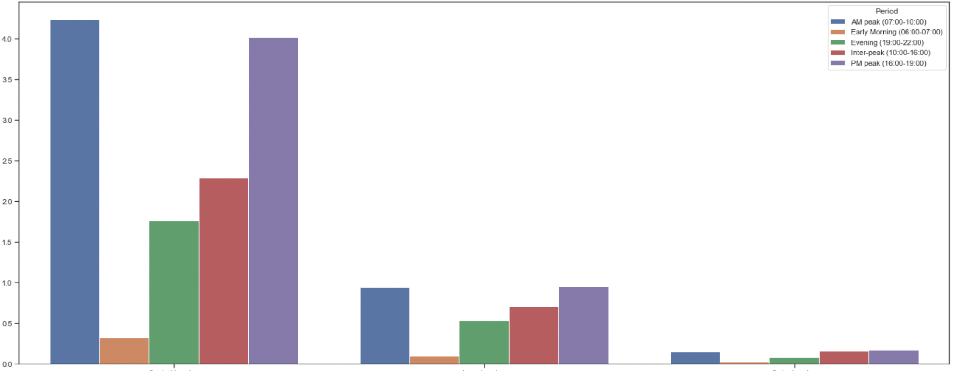
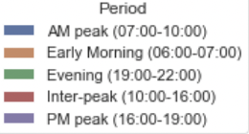
Most people cycle during the AM and PM peaks
Total cycles (M)
Central London
Inner London
Outer London

Slide 24
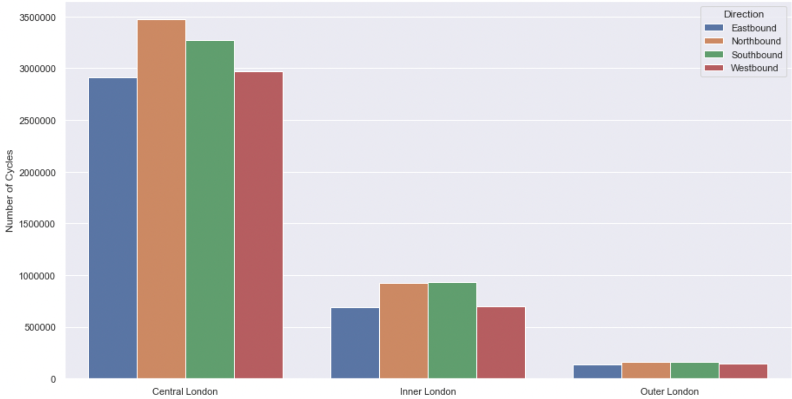
Northbound and southbound are the most popular directions of travel across London

Slide 25
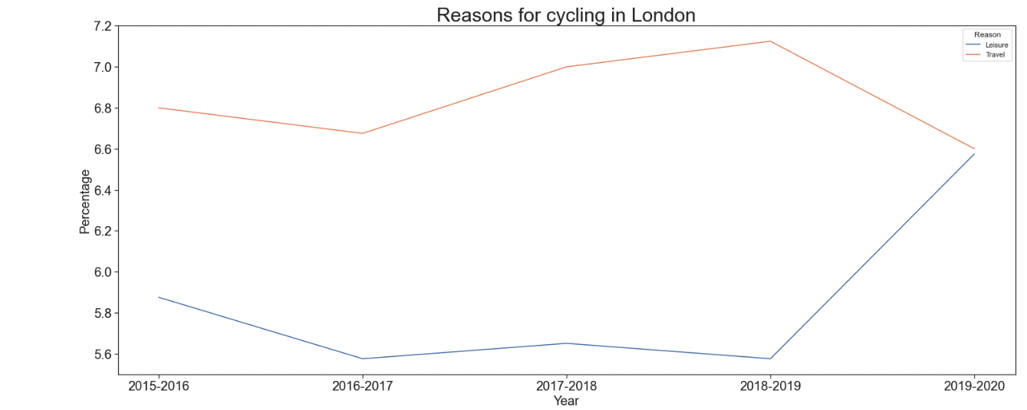
The majority of people cycle as a means of travel, rather than for leisure. However, these trends converged during the pandemic.
Reason
_____ Travel
_____ Leisure
Data: GOV.UK walking and cycling statistics page

Slide 26
Recommendations
Make it easier for people to commute via cycle:
Limit car traffic on main cycle routes during peak AM and PM hours.
Invest in more cycle lanes around major roads in central London.
Make it easier for people to cycle for exercise/leisure proposes:
Expand cycle scheme that encourages leisure to outer London.
Invest in more cycle lanes around outer ring of London.
Promote cycle to work scheme.
Promote marketing campaigns during good weather and also spring/summer season.

Slide 27
Business Case
Problem statement: How can we increase the uptake of cycling in London in order to create a more sustainable transport system?
What is the trend in total cycles over time?
Q1. What are the main factors determining when people cycle?
Q2. What impact does infrastructure have on cycling uptake and how can this be improved?
Q3. What are the demographics of cyclists in London?
Q4. What is the sentiment towards cycling in London?
Q5. How safe is it to cycle in London?
Areas of exploration: time of year; time of day; weather; direction of travel; reasons for cycling
Areas of exploration: private vs cycle hire; locations with the least number of cycles
Areas of exploration: gender
Areas of exploration: top words appearing; polarity score; top 20 positive/negative tweets
Areas of exploration: theft; road casualties
Data: TfL central, inner, outer datasets; GOV.UK walking and cycling statistics
Data: GOV.UK reported road casualties; data.london.gov.uk
Data: TfL central, inner, outer datasets
Data: TfL outer dataset
Data: Twitter
Notes:
Next, we explored what impact does infrastructure have on cycling uptake and how can this be improved.

Slide 28
Code considerations
Used groupby() and sort_values() to aggregate dataset and:
Identify percentage of private cycles and cycle hires each year
Identify direction with highest number of total cycles
Identify locations with least cycles sort by ascending order
Used seaborn lineplot and barplot to visualise above variables in each area.
Consider plotting on a map to view whether location correlates with each other.
Notes:
Used groupby() to
Identify percentage of private cycles and cycle hires each year
Identify direction with highest number of total cycles
and sort_values() by ascending to identify locations with least cycles
Used seaborn lineplot and barplot to visualise above variables in each area

Slide 29
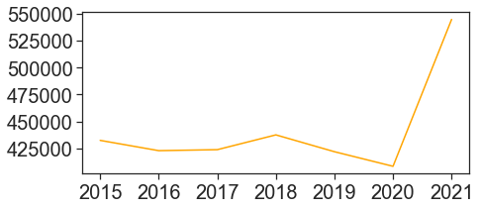
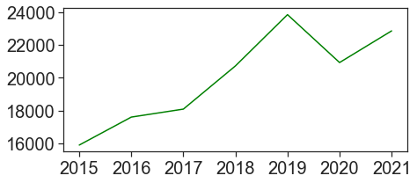
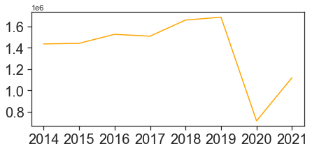
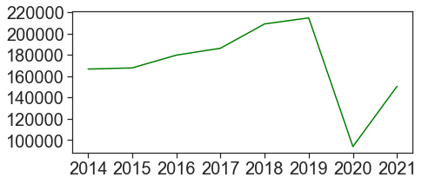
With 90% of the cycling population using private cycles and 10% using cycle hires, it is observed that people tend to cycle more when owning a private bike. While cycle hires were affected by the pandemic, private cycles in Inner London during the pandemic surpassed that of pre-pandemic.
Private Cycles
90%
Cycle hires
10%
Inner London
Central London
Notes:
Firstly, people tend to cycle more when they own a private bike as 90% of cyclist used private cycles and 10% used cycle hires in the last 7 years.
While cycle hires were affected by the pandemic with sharp decrease in 2020, private cycles in inner london during the pandemic surpassed that of pre-pandemic.

Slide 30
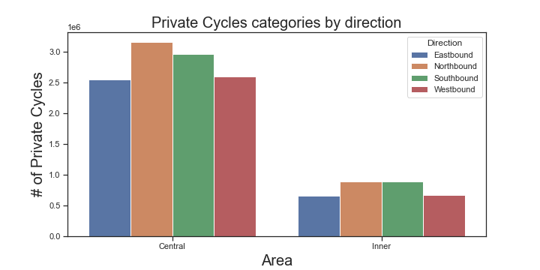
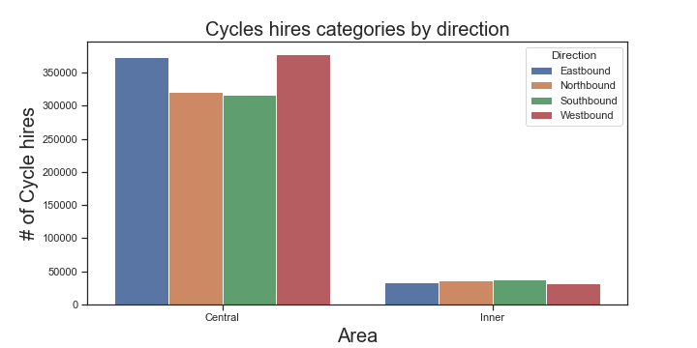
Consider implementing a cycle scheme to promote the purchase of private bikes in east and west of Central and Inner London.
Notes:
When looking at Central & Inner London, less people use private cycles to travel towards east and west bound

Slide 31
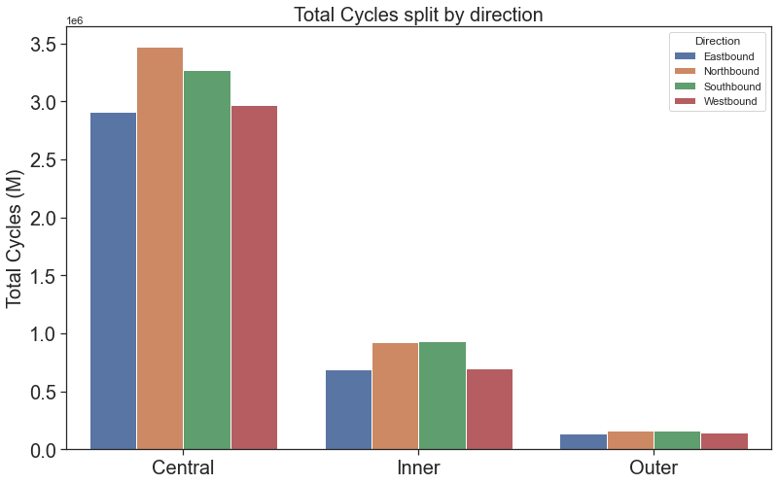
Consistent across 3 areas of London, least people cycled towards eastbound and westbound.
*Dataset: 2014-2021
Notes:
When we looked at total cycles across 3 areas, it is consistent people cycles less towards east and west and more people cycled towards north and south. TFL can consider targeting these areas to promote cycle scheme for purchase of private bikes.

Slide 32
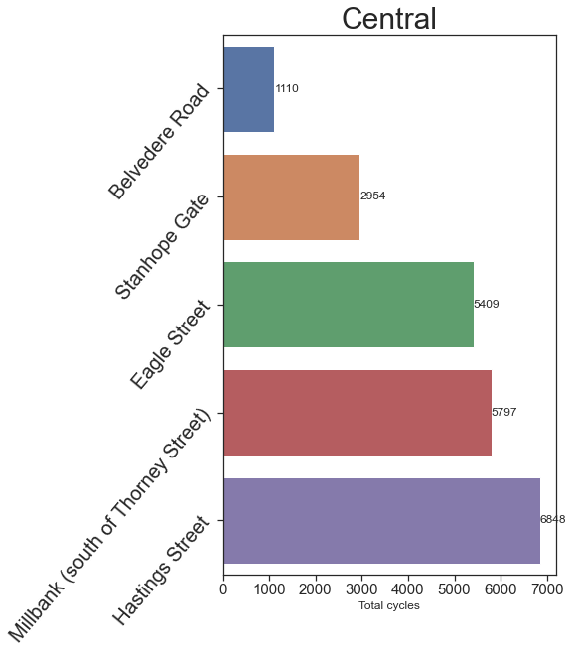
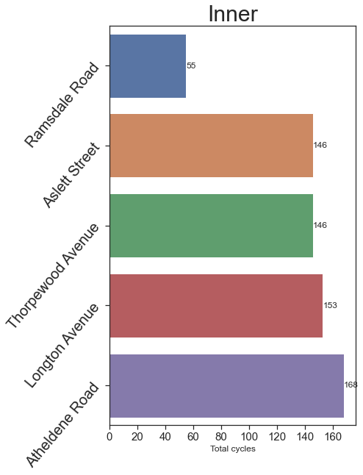
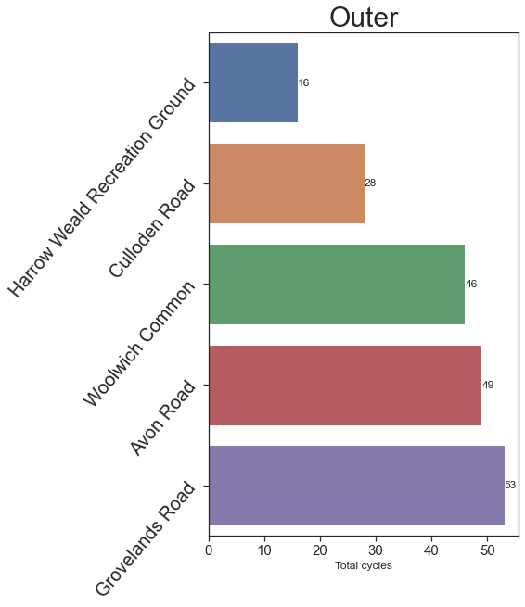
Focus on improving cycling roads towards east & west direction in the top 5 locations with least number of cycles of each area.
*Dataset: 2014-2021
Notes:
By subsetting data set according to locations with roads towards east and west, we identified the top 5 locations with the least number of cycles in the past 7 years.

Slide 33
Recommendations
Implement a cycle scheme to promote the purchase of private bikes beginning in east and west london to increase the uptake of cycling.
Improve facilities on the public transports (ie. train and bus) to accommodate long journey travellers who are carrying bikes. This will encourage more people to cycle once inside Central London.
Improve infrastructure at the top 5 locations with least number of total cycles such as building cycling roads or docking stations.
Notes:
Based on the analysis, we recommend to
Firstly, implement cycle schemes to promote purchase of private bikes beginning in east and west london to increase uptake of cycling.
Also, improve facilities on the public transports (ie. train and bus) to accommodate travellers carrying bikes to encourage long journey travellers to cycles once inside central london.
Lastly, improve infrastructure at the top 5 locations with least number of total cycles such as building cycling roads or docking stations.
Since there are least people cycling in Outer London, conduct further exploration to understand preferred mode of transport and assess whether it is correlated to cycling road safety or longer journeys from outer to central london.

Slide 34
Business Case
Problem statement: How can we increase the uptake of cycling in London in order to create a more sustainable transport system?
What is the trend in total cycles over time?
Q1. What are the main factors determining when people cycle?
Q2. What impact does infrastructure have on cycling uptake and how can this be improved?
Q3. What are the demographics of cyclists in London?
Q4. What is the sentiment towards cycling in London?
Q5. How safe is it to cycle in London?
Areas of exploration: time of year; time of day; weather; direction of travel; reasons for cycling
Areas of exploration: private vs cycle hire; locations with the least number of cycles
Areas of exploration: gender
Areas of exploration: top words appearing; polarity score; top 20 positive/negative tweets
Areas of exploration: theft; road casualties
Data: TfL central, inner, outer datasets; GOV.UK walking and cycling statistics
Data: GOV.UK reported road casualties; data.london.gov.uk
Data: TfL central, inner, outer datasets
Data: TfL outer dataset
Data: Twitter

Slide 35
Code considerations
Used sns bar plot and line plot for Univariate and Bi-variate Analysis analysis.
Analysed outliers through boxplots between total cycles and gender
Tried using a log scale for the cycling data to consolidate the numerous variable but the visualisation was very cluttered

Slide 36
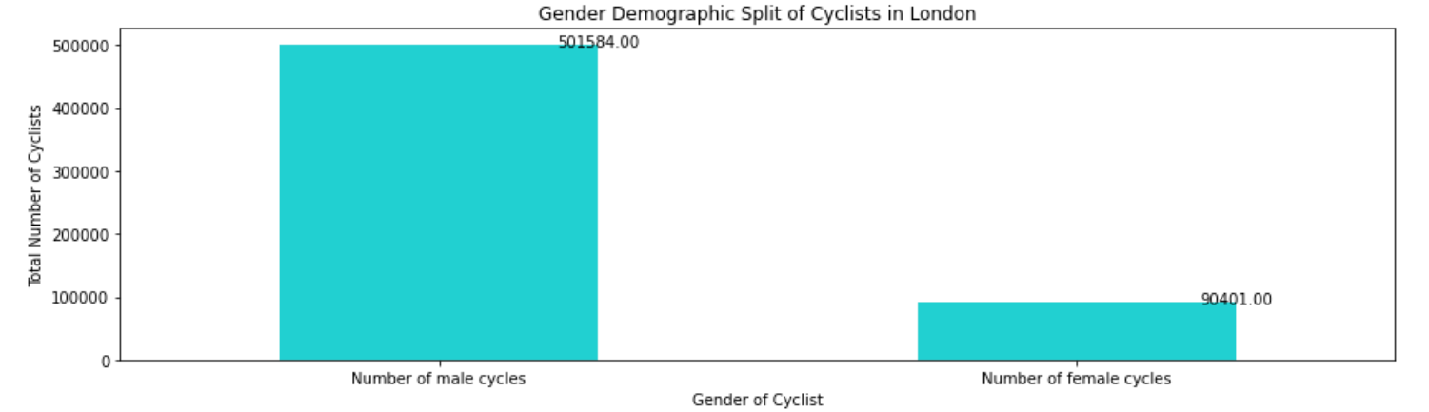
There are ~6x more Male cyclists than Female cyclists

Slide 37
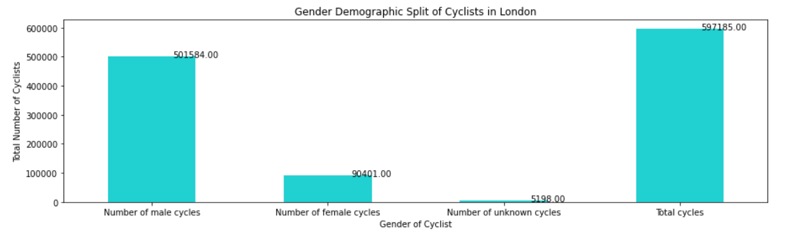
Male cyclists represent 83% of cyclist and Female cyclists 15%

Slide 38
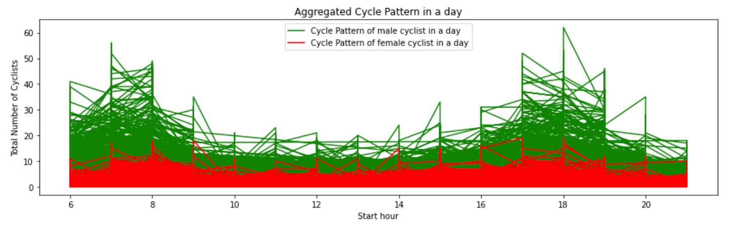
Male and Female cyclists follow the same cycle pattern within a day generally

Slide 39
Recommendations
How can we increase the uptake of cycling in London: In order to promote the cycling in London Transport of London can focus their efforts to increase the uptake of Women that represent 15% of the total cyclist.
Further study based on specific areas: As we can see from the regression analysis (see Appendix) there is not a positive correlation between total cycles and female cycles. As such there must be other factors that can explain the motivation of women to cycle.

Slide 40
Business Case
Problem statement: How can we increase the uptake of cycling in London in order to create a more sustainable transport system?
What is the trend in total cycles over time?
Q1. What are the main factors determining when people cycle?
Q2. What impact does infrastructure have on cycling uptake and how can this be improved?
Q3. What are the demographics of cyclists in London?
Q4. What is the sentiment towards cycling in London?
Q5. How safe is it to cycle in London?
Areas of exploration: time of year; time of day; weather; direction of travel; reasons for cycling
Areas of exploration: private vs cycle hire; locations with the least number of cycles
Areas of exploration: gender
Areas of exploration: top words appearing; polarity score; top 20 positive/negative tweets
Areas of exploration: theft; road casualties
Data: TfL central, inner, outer datasets; GOV.UK walking and cycling statistics
Data: GOV.UK reported road casualties; data.london.gov.uk
Data: TfL central, inner, outer datasets
Data: TfL outer dataset
Data: Twitter

Slide 41
Code considerations
Road accident/casualties data from GOV.UK website: Reported road accidents, vehicles and casualties tables from Great Britain. This can be found on: https://www.gov.uk/government/statistical-data-sets/reported-road-accidents-vehicles-and-casualties-tables-for-great-britain#casualties-in-reported-road-accidents-ras30.
The file used was: "RAS30043: Casualties by severity, region, local authority and road user type: England." This data in this file was extracted, rearranged, and converted into a csv file in Excel and then read into Python for analysis.
Data for bicycle thefts across London boroughs was collected from the London Datastore - Recorded Crime Geographic breakdown file which covered 24 months of recorded crime. The data was provided in csv format and fed into Python for analysis after brief data exploration on Excel.

Slide 42
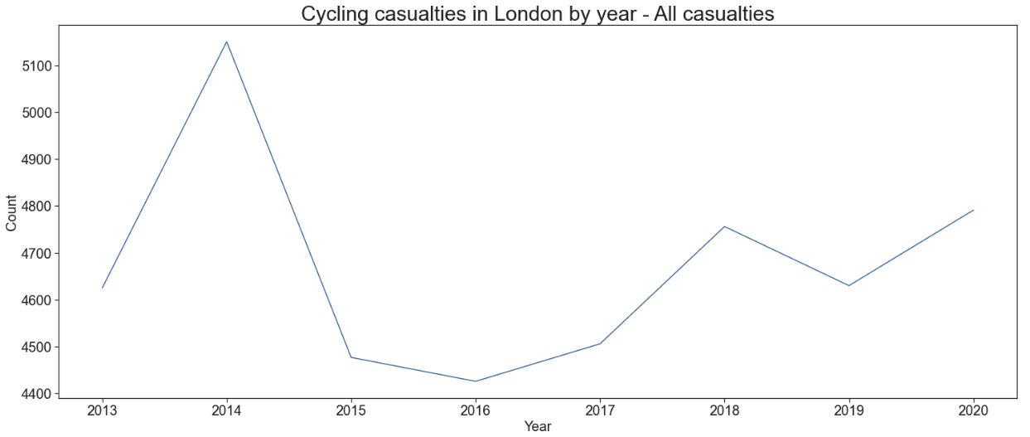
Cycling casualties declined between 2014 and 2016 but have been gradually increasing since then (with a decline between 2018-2019)
Data: GOV.UK website: Reported road accidents, vehicles and casualties tables for Great Britain

Slide 43
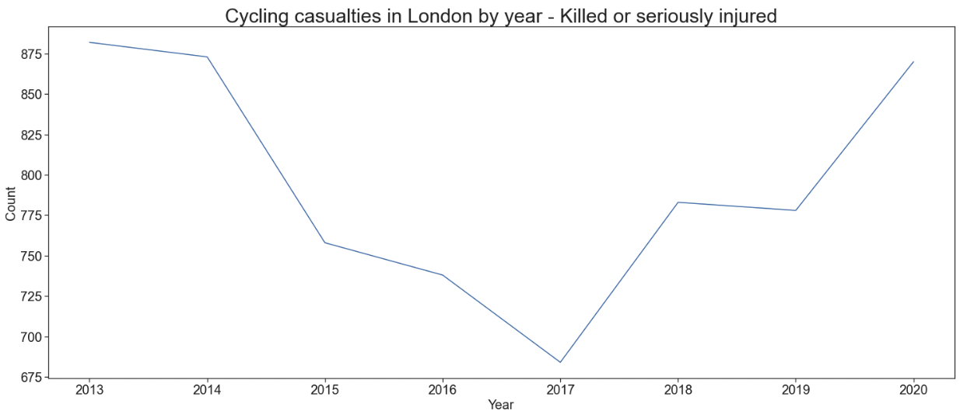
A similar trend is observed for the number of serious/fatal cycling casualties, in which there is a decline from 2014-2017 but increasing serious/fatal casualties from 2017, onward.
Data: GOV.UK website: Reported road accidents, vehicles and casualties tables for Great Britain

Slide 44
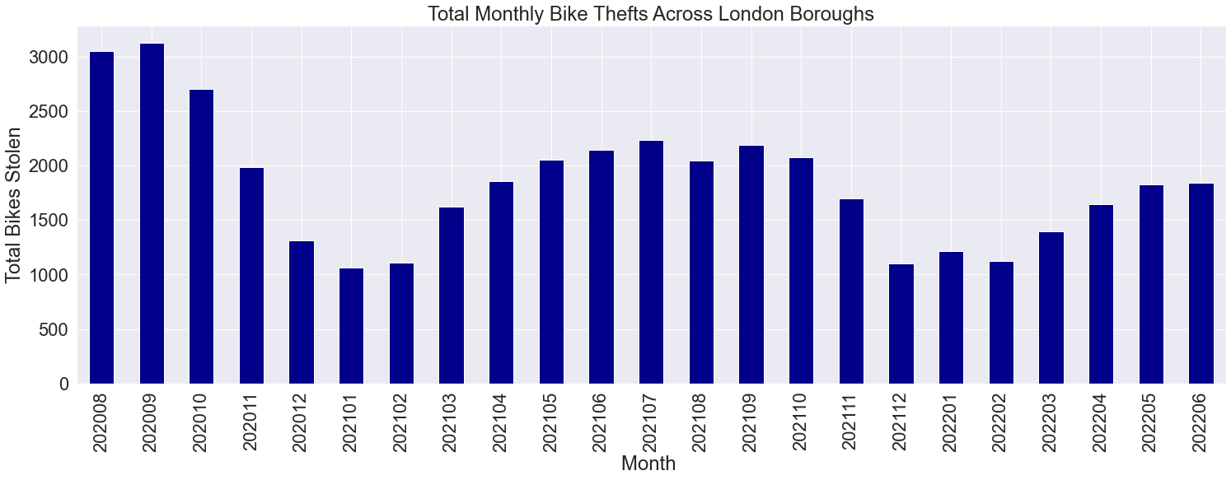
In general, bicycle thefts have decreased over time. Peaks tend to occur during warm-weather months.
Data: data.london.gov.uk

Slide 45
Recommendations
Investigate possible reasons why cyclist casualties began decreasing from 2014 but then started increasing in 2016/2017
Prioritise reduction of serious and fatal cyclist accidents
Look into ways of building surveillance around bicycle theft during the warmer months (spring/summer)

Slide 46
Business Case
Problem statement: How can we increase the uptake of cycling in London in order to create a more sustainable transport system?
What is the trend in total cycles over time?
Q1. What are the main factors determining when people cycle?
Q2. What impact does infrastructure have on cycling uptake and how can this be improved?
Q3. What are the demographics of cyclists in London?
Q4. What is the sentiment towards cycling in London?
Q5. How safe is it to cycle in London?
Areas of exploration: time of year; time of day; weather; direction of travel; reasons for cycling
Areas of exploration: private vs cycle hire; locations with the least number of cycles
Areas of exploration: gender
Areas of exploration: top words appearing; polarity score; top 20 positive/negative tweets
Areas of exploration: theft; road casualties
Data: TfL central, inner, outer datasets; GOV.UK walking and cycling statistics
Data: GOV.UK reported road casualties; data.london.gov.uk
Data: TfL central, inner, outer datasets
Data: TfL outer dataset
Data: Twitter

Slide 47
Code considerations
Search terms: “london uk cycle”
Date of search: 11-Aug-2022
Retweets filtered out to reduce duplications and to make the full tweet text available when analysing the top 20 positive and negative tweets
84 tweets in total analysed (following de-duplication)

Slide 48
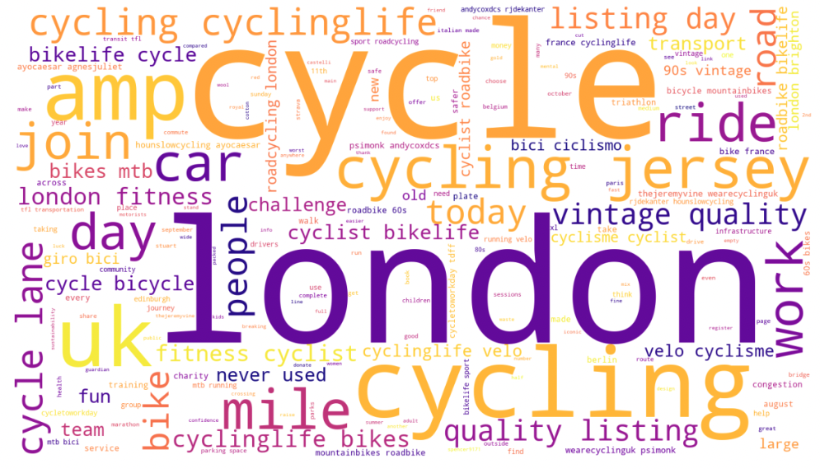
The top words appearing were associated with the search terms, fitness, listings, and infrastructure. Possible influencers (e.g. thejeremyvine, wearecyclinguk, hounslowcycling) appear in the wordcloud, and could be worth investigating for marketing purposes.

Slide 49
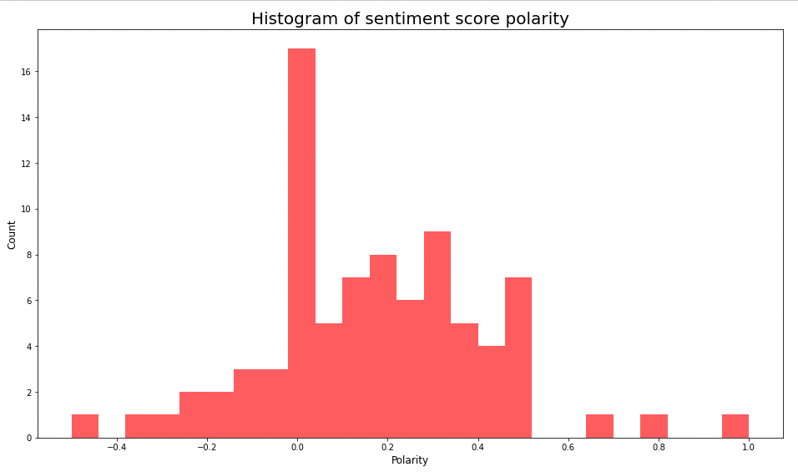
Most tweets about “london uk cycle” tend to be neutral to positive
negative neutral positive

Slide 50
Positive tweets indicate a good perception of cycling events, like cycle to work day and initiatives to increase female cyclists. Meanwhile, negative tweets indicate that more work could be done to increase cyclist safety, to increase the number of cycle lanes available, and encourage more people to use the cycle lanes.
Positive tweets
Negative tweets
it’s #cycletoworkday, marking 10 years of the uk’s biggest #cycle commuting event. https://t.co/ilipis5fe1 is perfectly positioned to take advantage of the infrastructure investment that has been made to encourage #cycling in london, with the cycle superhighway on our doorstep.
a cyclist’s gopro has shown just how terrifying it can be to cycle through central London
transport: better transport needs to be more accessible and available across the uk, not just london. (london’s lucky to have its transport system to be fair) reduce train costs, build more cycle lanes, create new bus routes, more walking routes + (a bridge in east london plz)
in the uk there is no congestion caused by cycle lanes. every day london is a sea of red on google maps, and the worst roads aren't anywhere near any cycle lanes.
"i hadn’t anticipated the power of a group of women on bikes. so many of the women hadn’t ridden since childhood, or even learnt to ride, so seeing them on the bikes, their confidence and their smiles was contagious and inspiring"
"the cycle lane that's always empty".
Full list of top 20 positive and negative tweets listed in Appendix

Slide 51
Recommendations
Scrape Twitter data across different days/months to see if the analysis results are similar or if they differ
Twitter data could be used as the basis for a more thorough investigation into attitudes and beliefs about cycling in London (e.g. through a survey)
Consider approaching possible influencers on Twitter to promote TfL cycling improvements
Promote or sponsor cycling events to increase positive perceptions around cycling
Look into infrastructure and safety concerns of cyclists to decrease negative perceptions around cycling

Slide 52
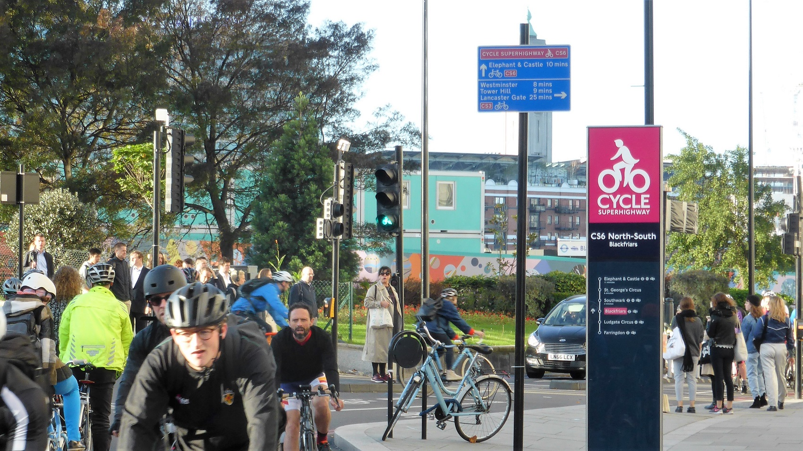
Conclusion

Slide 53
How can we increase the uptake of cycling in London in order to create a more sustainable transport system?
01
Limit car traffic during peak AM and PM hours
Invest in more cycle lanes around major roads in central London
Look into the accessibility of taking bikes on public transit, as it could convince those with longer journeys to cycle at least part of the way
Promote cycle to work scheme
Make it easier for people to commute via cycle
02
Make it easier for people to cycle for exercise/leisure purposes
Expand cycle scheme that encourages leisure to outer London
Invest in more cycle lanes around outer ring of London
03
Improve infrastructure and safety
Look into ways that infrastructure can be improved in areas with the least amount of cyclists
Examine social media and/or conduct a survey to better understand the top infrastructure/safety related concerns of London cyclists
Investigate reasons why cycling casualties decreased in 2014 but started increasing again from 2016/2017
04
Ensure that any marketing campaigns have maximum impact
Promote marketing campaigns during the spring/summer when people are more inclined to cycle due to good weather/longer days
Consider approaching social media influencers to promote cycle improvements
05
Promote or sponsor cycling events
Targeted events could increase cycling among groups who don’t cycle as much (e.g. women)
Could better promote new infrastructure changes

Slide 54
Further areas of exploration
Conduct GIS analysis of location of cycle lanes and cycle infrastructure to better identify locations that need better infrastructure
Collect and examine other demographic attributes of cyclists (e.g. ethnicity, education, age) to ascertain whether there are any populations that could be encouraged to cycle more

Slide 55
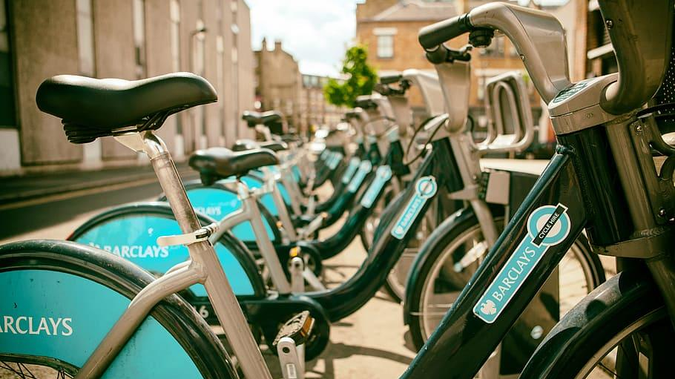
“London must become a city where walking, cycling and green public transport become the most appealing and practical choices for many more journeys…With an ever-growing population set to put increasing pressure on our city’s infrastructure and public spaces in the coming years, it is important that we start to make these changes now.”
(Mayor’s Transport Strategy 2018)

Slide 56
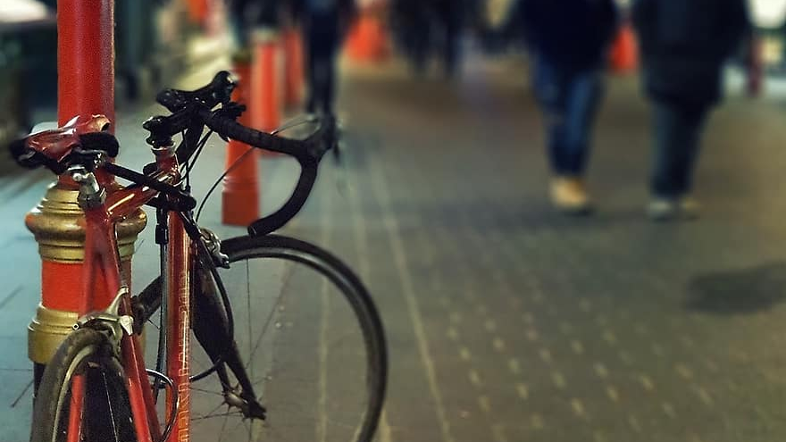
Appendix

Slide 57
Coding scripts and data sources
Business question | Scripts used* | Data sources
What is the trend in total cycles over time? | Q1_Factors_RZ_Final.ipynb | Central London, Inner London, Outer London
Q1. What are the main factors determining when people cycle? | Q1_Factors_RZ_Final.ipynb Q1_Factors (Reasons why people cycle)_MB_Final.ipynb Q1_Factors (Time of year, Time of Day, Weather, Direction)_MB_Final.ipynb Q1_Factors (Regression analysis)_MB_Final.ipynb | Central London, Inner London, Outer London GOV.UK walking and cycling statistics page (file: CW0302)
Q2. What impact does infrastructure have on cycling uptake and how can this be improved? | Q2_Infrastructure_HC_Final.ipynb | Central London, Inner London, Outer London
Q3. What are the demographics of cyclists in London? | Q3_Demographics_TM_Final.ipynb | Outer London
Q4. What is the sentiment towards cycling in London? | Q4_Sentiment_MB_Final.ipynb | Twitter (accessed 11-Aug-2022)
Q5. How safe is it to cycle in London? | Q5_Safety (Road accidents and casualties)_MB_Final.ipynb Q5_Safety (Bicycle Theft)_AL_Final.ipynb | GOV.UK website: Reported road accidents, vehicles and casualties tables for Great Britain (file: RAS30043) data.london.gov.uk
*See GitHub link for full scripts

Slide 58
While all major variables in the TfL datasets were significant, the number of private cycles explained the greatest variance in the number of total cycles in central and inner London. Meanwhile, the number of male cyclists explained the greatest variance in the number of total cycles in outer London.
Central London
Inner London
Outer London
Variable | Significance* | Variance in total cycles explained by variable**
Number of private cycles | High p < 0.001 | 99.3%
Number of cycle hires | High p < 0.001 | 57.1%
Time of day (Period) | High p < 0.001 | 11.6%
Weather | High p < 0.001 | 0.3%
Time of year (Quarter) | High p < 0.001 | 0.2%
Variable | Significance* | Variance in total cycles explained by variable**
Number of private cycles | High p < 0.001 | 99.4%
Number of cycle hires | High p < 0.001 | 18.5%
Time of day (Period) | High p < 0.001 | 6.1%
Time of year (Quarter) | High p < 0.001 | 0.3%
Weather | High p < 0.001 | 0.2%
Variable | Significance* | Variance in total cycles explained by variable**
Number of male cyclists | High p = 8.1 x 10⁶ | 95.6%
Number of female cyclists | High p < 0.001 | 45.7%
Time of day (Period) | High p < 0.001 | 3.3%
Time of year (Quarter) | High p < 0.001 | 1.1%
Weather | High p < 0.001 | 0.2%
*Measured by calculating the P-value. The closer the P-value is to 0, the greater the significance. Generally, values under 0.05 are considered significant.
**Measured by calculating the adjusted R-squared value.

Slide 59
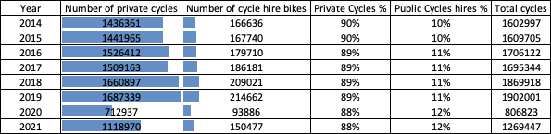
90% of cyclists use private cycles while only 10% hire public cycles
Notes:
Overall, 90% of cyclists use private cycles while only 10% hire public cycles in inner and central london. This is consistent year over year since 2014.

Slide 60
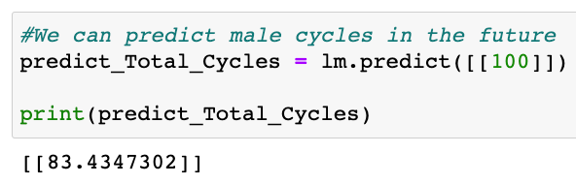
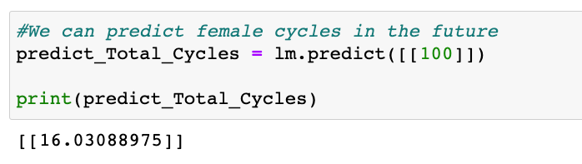
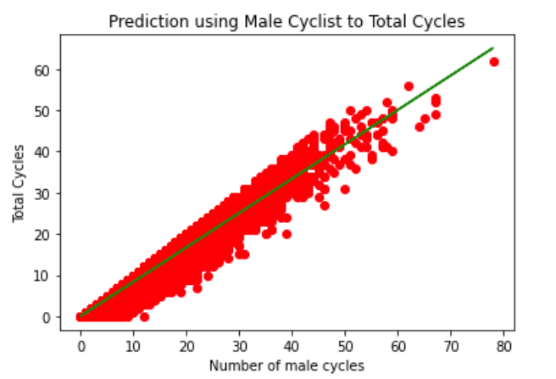
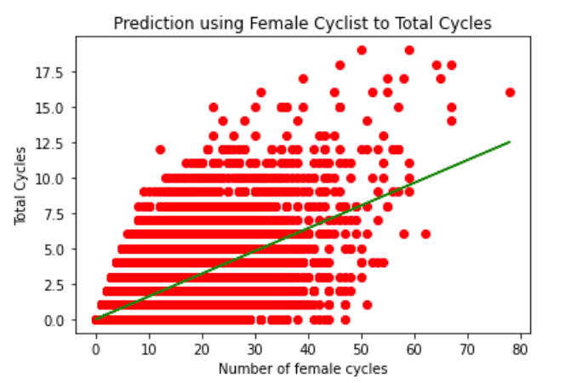
Male and Female cyclist can be used to predict future total cycles

Slide 61
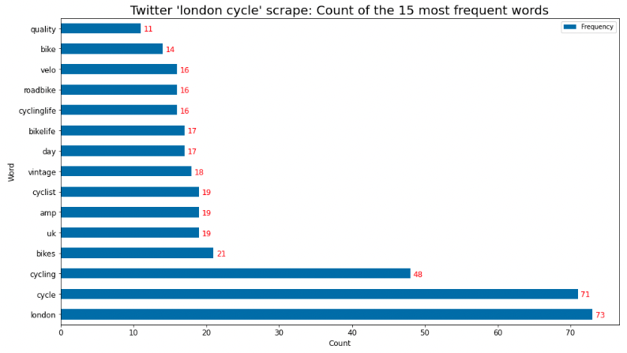
Top words appearing in tweets about london uk cycling

Slide 62
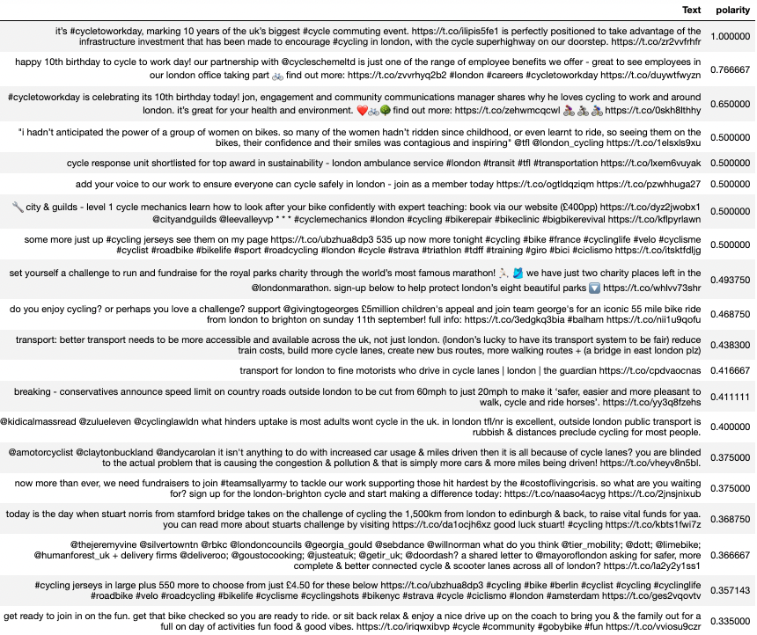
Top 20 positive Tweets

Slide 63
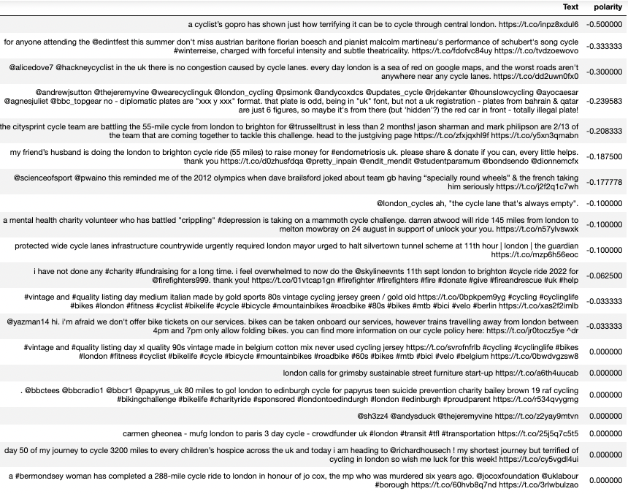
Top 20 negative Tweets

